Slide 1
FranClusterer App Instructions
Welcome to FranClusterer!
These step-by-step instructions will guide you through the process of analyzing your retail outlet data for geographic clustering and potential survival rates.

Slide 2
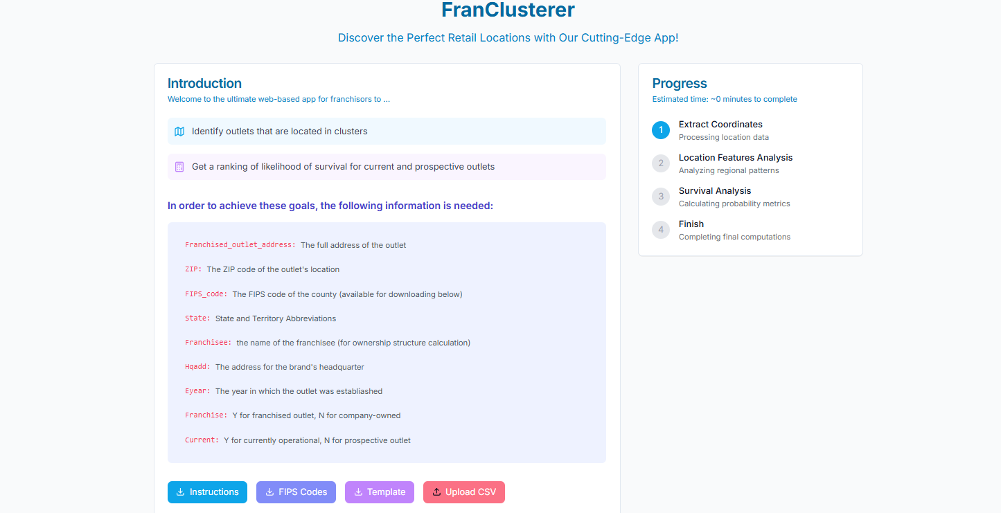
Step 1: Uploading Your Data
1. Visit the FranClusterer website (https://franclusterer.com/) to start.
2. Upload your CSV file containing your retail outlets' data by clicking on the “Upload CSV” button. Please ensure it follows the format provided on the website.
1
2
2

Slide 3
Step 1: Uploading Your Data （Cont’l)
3. Download the CSV template by clicking on the “Template” button to familiarize yourself with the required data structure. You can also use this template for your initial upload to test the system.
4. For reference, FIPS codes can be found by clicking on the “FIPS Codes” button.
5. If you need to extract current outlet addresses from Franchise Disclosure Documents (FDDs), please refer to the detailed instructions provided in the Appendix of this file.
4
3

Slide 4
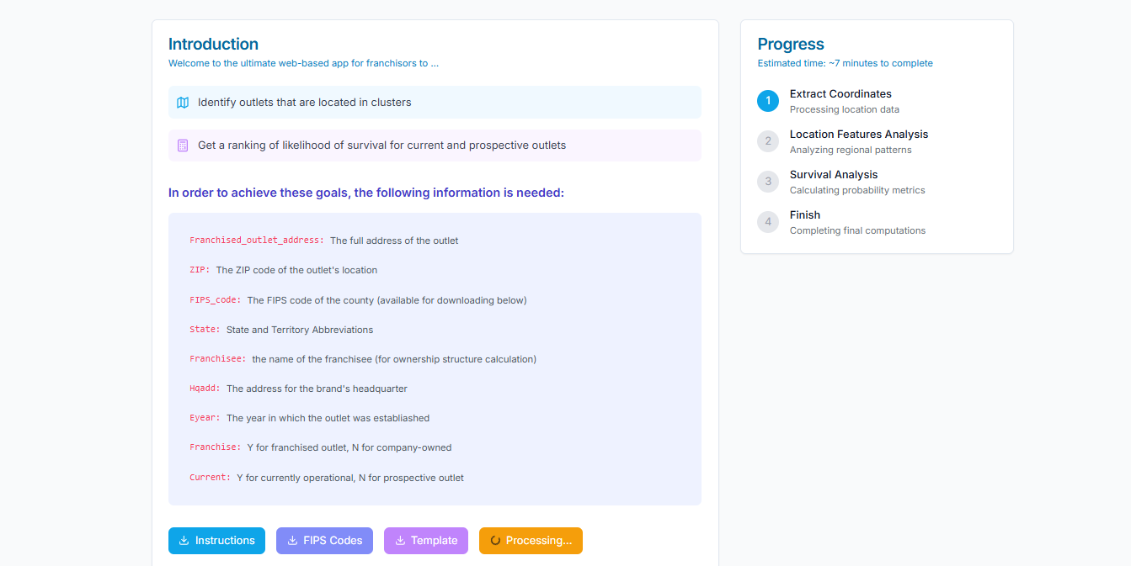
Step 2: Data Processing
1. Once your file is uploaded, the website will display an estimated processing time and the necessary steps of data processing. The system converts address information to geographic coordinates, which takes about 10 seconds per address. Larger datasets may result in longer processing times.
2. During processing, a progress animation on the Processing button will be visible. Please be patient as the data are being processed.
1
2

Slide 5
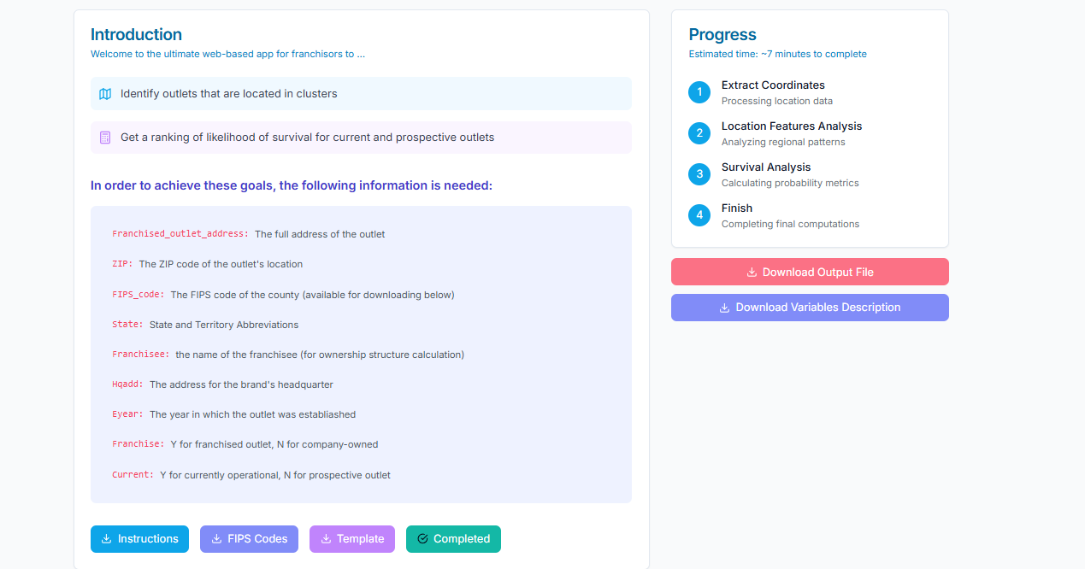
Step 3: Analyzing the Results
1. Once data processing is finished, the status of the Processing button will change to “Completed”.
2. Download your results and the accompanying variable description by using the provided download buttons.
2
1

Slide 6
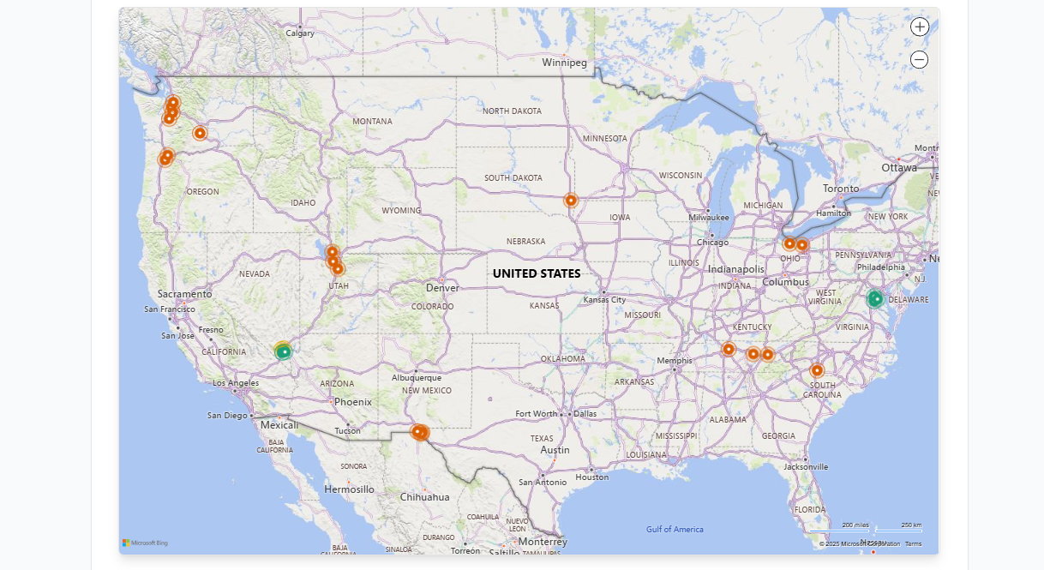
Step 4: Visualizing Data on the Map
1. Meanwhile, you can move to the map to visually assess your outlets. Dots on the map represent outlet locations:
Green dots signify outlets in clusters while dots indicate outlets outside of clusters. Orange dots represent the prospective outlets in clusters.

Slide 7
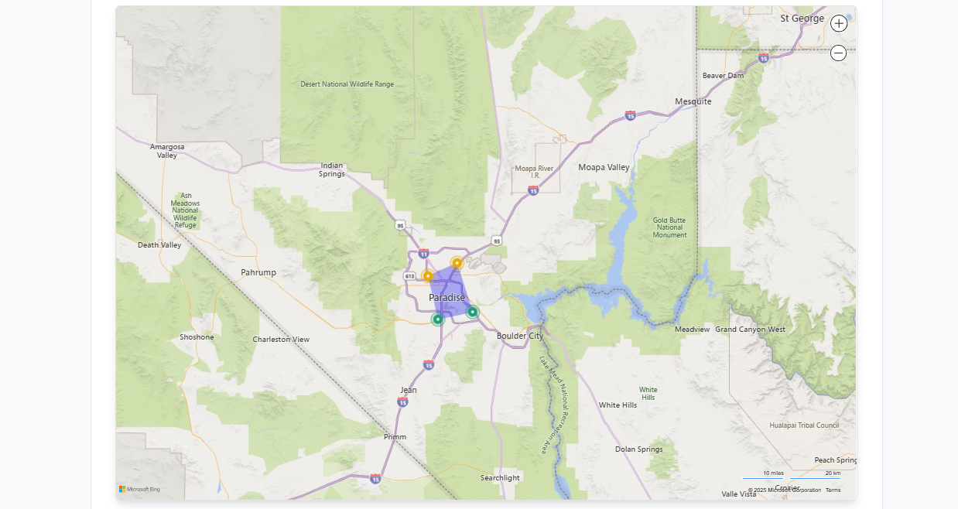
Step 4: Visualizing Data on the Map (Cont’l)
2. For a detailed view of clusters, simply zoom in on the map. As you do so, polygons will appear, outlining the perimeters of these clustered areas.

Slide 8
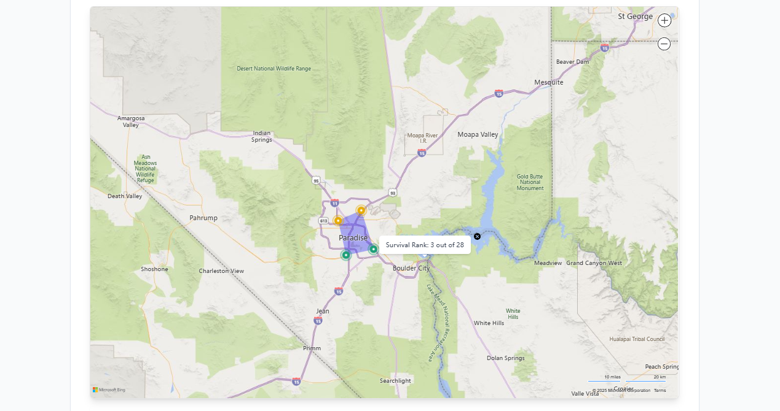
Step 5: Survival Rate Comparison
By hovering your cursor over a point on the map, you can see the rank of its expected survival rate for that specific outlet. It enables you to compare the expected survival rates among outlets within the franchise system.

Slide 9
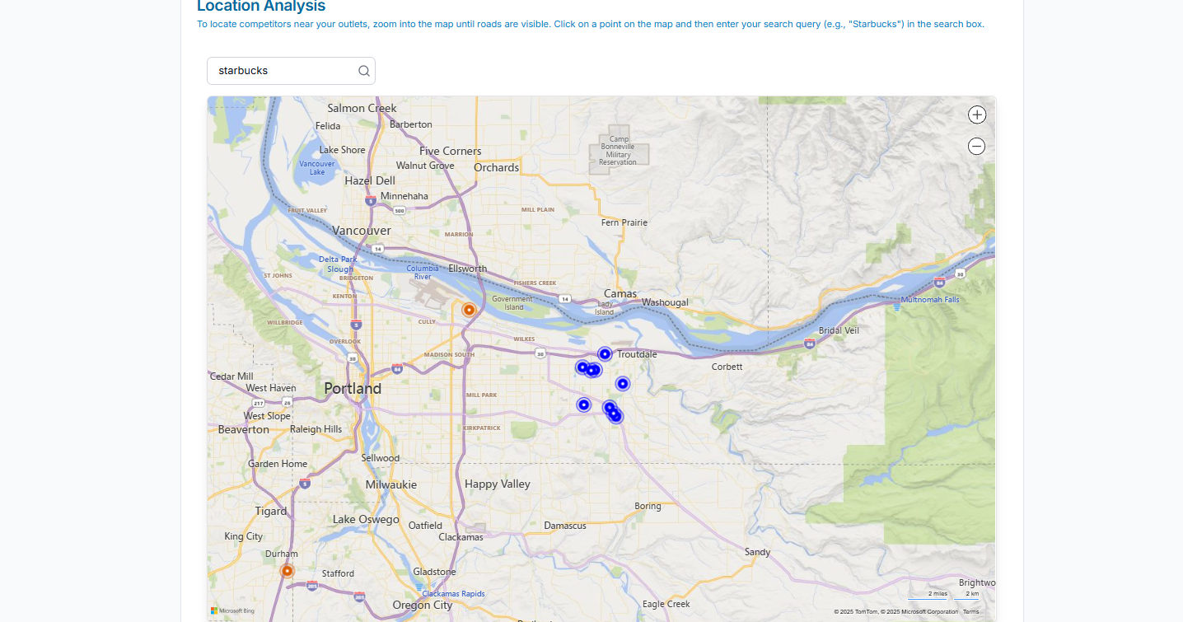
Step 6: Search for Competitors
To locate competitors near your outlets, zoom into the map until roads are visible. Click on a point on the map and then enter your search query (e.g., "Starbucks") in the search box. Competitor locations will then appear as blue dots on the map.

Slide 10
Appendix
Extracting Outlet Addresses from FDDs

Slide 11
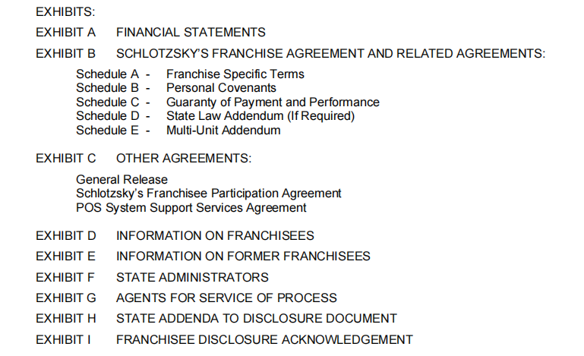
Step 1: Locate the list of Current Franchisees.
The list of current franchisees is typically found in one of the exhibits of FDDs.

Slide 12
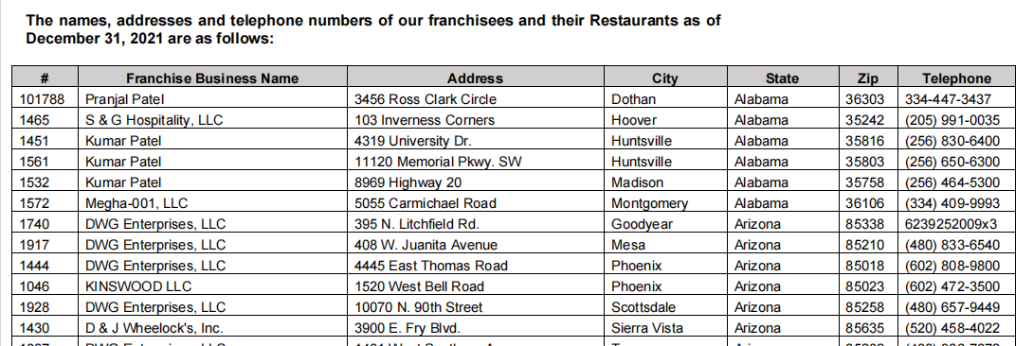
Step 2: Copy the addresses in the list of Current Franchisees to the template.
The list of current franchisees includes details such as franchisee name, addresses, and zip codes for each franchised store. Copy this information into the columns in the template accordingly.

